Slide 1
Evaluating Rabies Risk Exposures
Presenter:

Slide 2
Goals
Ensure appropriate treatment of individuals who may have sustained unreported or incompletely treated rabies risk exposures
  Ensure assessment is routine part of post-deployment evaluations
  Ensure appropriate care for persons identified with risk (theater encounter, PDHA/PDHRA responses, self report)
Ensure all persons presenting with rabies risk exposures receive appropriate care
Notes:
The goals of today's presentation is to ensure you are familiar with the appropriate treatment of all persons presenting with rabies risk exposures, whether acute or delayed. Assessment of rabies risk exposures should be a routine part of post-deployment evaluations as well.

Slide 3
Agenda
Review of rabies epidemiology, disease and treatment
Approach to preventive care for risk exposures
  Acute presentations
  Delayed presentations
Resources
Notes:
Here is the agenda

Slide 4
Human Rabies Update
A US Soldier died from rabies in AUG 2011
  Acquired from a dog bite while deployed in Afghanistan
  First case in DoD in over 30 years
  Symptoms began 3 months after redeployment
  AR 15-6 investigation currently ongoing
Public health investigation into case revealed 11 other Soldiers in unit had sustained unreported and untreated rabies risk exposures
  Mostly dog bites
  Several persons had more than one exposure
  10 required post-exposure prophylaxis
Notes:
So why all the sudden concern about rabies? In August 2011, a US Soldier died from rabies acquired from a dog bite while deployed in Afghanistan. This represents the first case in DoD in over 30 years. His symptoms began 3 months after redeployment. However, the bigger concern: Public health investigation into case revealed 11 other Soldiers in unit had sustained unreported and untreated rabies risk exposures. Most of these were dog bites, but some reported cat or monkey bites, too. Several persons had more than one exposure. 10 of these persons sustain exposures that were deemed to require post-exposure prophylaxis.

Slide 5
Rabies Outside United States
55,000 people die of rabies world-wide every year
  US typically reports only 1-2 human cases per year
  Dogs are the most common vector in developing countries
    Lack of vaccination programs
    US travelers may not realize risk
  Fewer than 10 survivors known
Once symptoms develop, almost uniformly fatal
  Early treatment prevents nearly 100% disease
  Treatment before symptoms begin can still be effective
    Most survivors had some history of vaccination
    Only three survivors with no prior history of preventive care
CDC guidance is written primarily for risk in US, not other countries and not for military deployments!
Notes:
Rabies is a bigger problem abroad than in the US. World-wide, 55,000 people die of rabies year, but in the US there are usually only 1-2 human cases per year. Dogs are the most common vector in developing countries, but bats are the most common source of rabies disease in the US. Developing countries typically cannot support routine rabies vaccination programs for dogs and cats. There may be cultural differences in the concept of pets. And US travelers may not realize how different the risk is.
Of all human rabies cases, fewer than 10 survivors have been documented. Once symptoms develop, rabies is almost uniformly fatal. However, early treatment prevents nearly 100% of disease. And although delays in treatment are not ideal, treatment before symptoms begin can still be effective. Most survivors had some history of vaccination. There have been only three survivors with no prior history of preventive care. It is important to understand that CDC guidance is written primarily for risk in US, not other countries and not for military deployments!

Slide 6
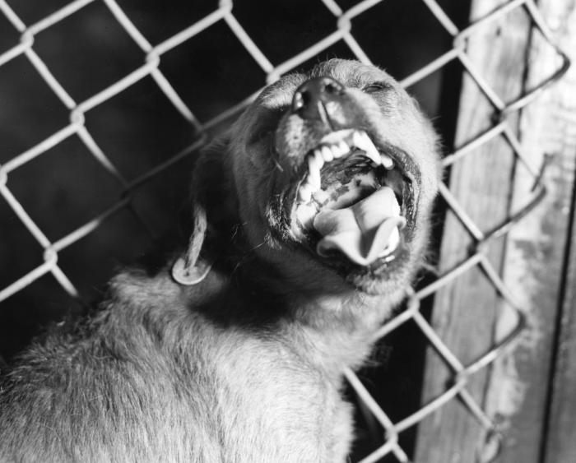
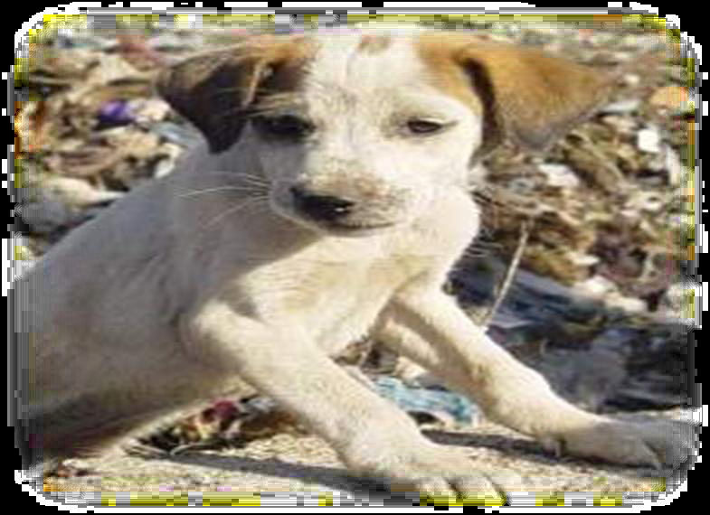
Rabid Animals
PHOTO: CDC PHIL
PHOTO: U.S. ARMY
You cannot tell whether an animal has rabies
by observing its actions.
Both of these dogs have rabies.
Notes:
Despite common lore, you cannot tell whether an animal has rabies by observing its actions. Both of these animals are rabid. The puppy on the right was a “fob dog.” More than 20 people were exposed and required post-exposure treatment, costing over $22,000 in HRIG and vaccine alone.

Slide 7
Rabies Disease
Caused by RNA viruses in the family Rhabdoviridae, genus Lyssavirus
Virus is transmitted through contact with the saliva of infected, or rabid mammals, such as dogs, cats, bats, skunks, raccoons, foxes, mongooses and jackals
  Mice, rats and other small rodents are almost never found to be infected with rabies.
  Larger rodents, such as groundhogs or beavers, can be infected
  Herd animals, such as horses, cows, etc., can be infected
In CNS, virus causes acute, progressive encephalomyelitis
Incubation period: Average 1 to 3 months after untreated exposure
  Most people who develop rabies do so in 12 months
  Can be only days; rarely longer than one year after exposure
  Depends on virus inoculum, distance from CNS and other factors
  Bites to the head or neck usually have the shortest incubation periods
Notes:
Rabies is caused by an RNA virus in the family Rhabdoviridae, genus Lyssavirus. The virus is transmitted through contact with the saliva of infected, or rabid, warm-blooded animals, such as dogs, cats, bats, skunks, raccoons, foxes, jackals and even mongooses. Mice, rats and other small rodents are almost never found to be infected with rabies, but larger rodents, such as groundhogs or beavers, can be infected. Larger animals are more likely to survive an encounter with another rabid animal and thus develop the disease themselves. Similarly, herd or farm animals, such as horses, cows, etc., can be infected. In March 2010, a horse in Michigan was found to have rabies. 6 people required post-exposure prophylaxis, including the owner, trainer, and veterinarian. The horse had never been vaccinated. (ProMed mail)
Once the rabies virus is introduced into the body, it replicates in muscle, then finds its way to nerves. From distal nerves the virus travels to the central nervous system, where it causes an acute, progressive encephalomyelitis. Because of variability in bite location and virus inoculum, the incubation period of rabies can vary from a few days to over a year. The average is 1 to 3 months after an untreated exposure. Most people who develop rabies do so within 12 months of an untreated exposure; only rarely does it develop more than one year after exposure. Because bites to the head or neck allow the virus a shorter trip to the CNS, such bites usually have the shortest incubation periods.

Slide 8
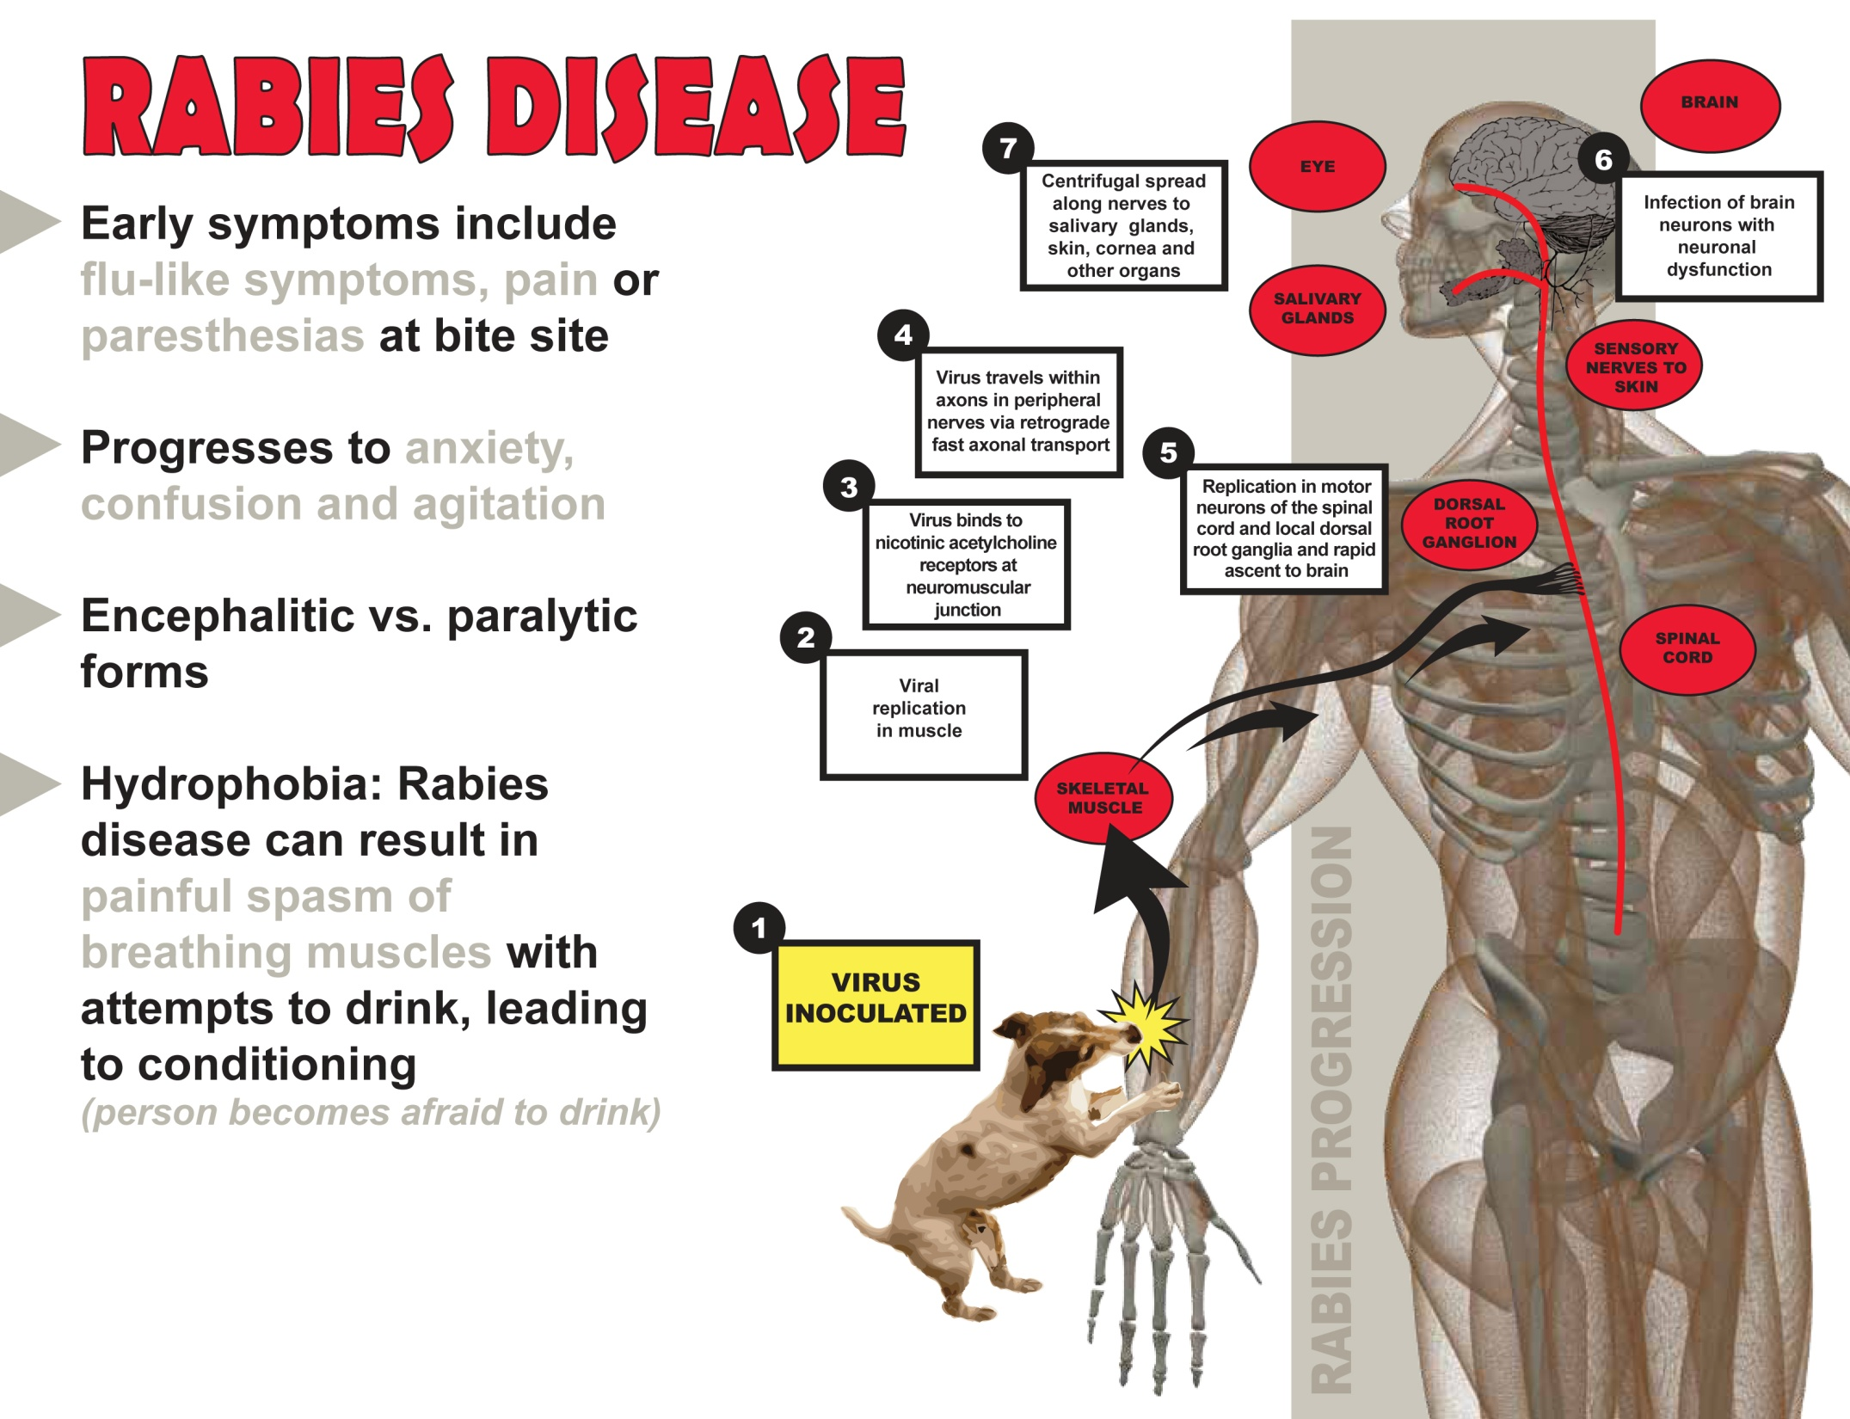
10.2012

Slide 9
Rabies Diagnosis & Treatment
Combination of tests needed to confirm diagnosis ante-mortem
  No single test is sufficient
  Saliva: Virus isolation or RNA detection with RT-PCR
  Serum & spinal fluid: Antibodies to rabies virus
  Punch skin biopsy of neck: Detect rabies antigen in cutaneous nerves of hair follicles
Once symptoms begin, no known effective treatment
  Care is primarily supportive; ICU care required
  Experimental administration of anti-viral drugs
  Suppression of brain activity with sedatives may help reduce inflammatory effects of virus
The best treatment is PREVENTION
  Thorough cleansing of wounds as soon as possible
  Timely completion of vaccine series and administration of human rabies immunoglobulin as appropriate
Notes:
Rabies in live persons is diagnosed with a combination of tests, as no single test is sufficient (usually a brain biopsy is not performed). Tests include virus isolation or RNA detection in saliva; detection of rabies antibodies in serum and CSF; and detection of rabies antigen in the cutaneous nerves of hair follicles (from a punch biopsy of skin at the back of the neck).
Once symptoms begin, there is no known effective treatment. Care is primarily supportive, and ICU care is usually required. Suppression of brain activity with sedatives may help reduce inflammatory effects of virus, as may experimental uses of antiviral drugs. A treatment protocol known as the “Milwaukee protocol” has been credited with enabling two persons to survive. However, the protocol or variations of it have been tried on a number of other persons without success, giving it about an 8% survival rate. Consequently, the best treatment is PREVENTION: Thorough cleansing of wounds as soon as possible, along with the timely completion of vaccine series and administration of human rabies immunoglobulin as appropriate.

Slide 10
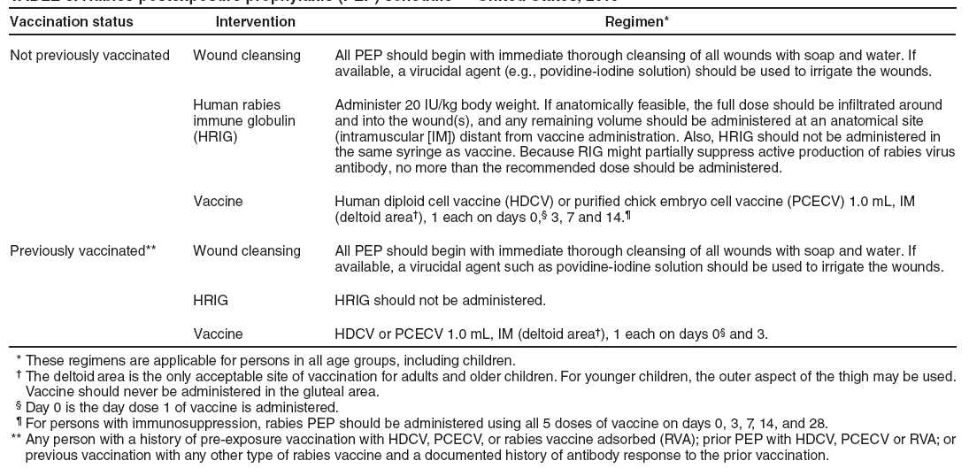
Rabies Post-Exposure Prophylaxis (PEP),
United States, 2010
Notes:
This table from March 2010 MMWR summarizes post-exposure treatment protocols.

Slide 11
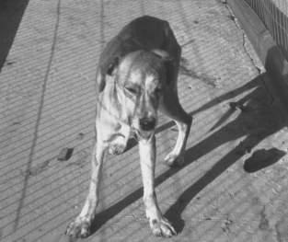
Rabies and Deployment
Although rabies can infect any mammal, mice, rats and other small rodents are almost never found to be infected with rabies. These bites do not require rabies prophylaxis.
Other than military working dogs, there are no “safe” dogs or cats when deployed.
  ~10% of animals tested from Afghanistan were positive
Vets in theater do not routinely vaccinate feral animals
PHOTO: CDC PHIL
A rabid dog, cat, or monkey can look and behave normally —even during a veterinary exam. The rabid dog above is calm with advanced disease.
Notes:
Although rabies can infect any mammal, mice, rats and other small rodents are almost never found to be infected with rabies. These bites do not require rabies prophylaxis. Other than military working dogs, there are no “safe” dogs or cats when deployed. Between January 2010 and August 2011, the Veterinary Lab Europe tested 44 animals from Afghanistan. 4 tested positive; each of these positive animals had bitten at least one military member. Keep in mind that veterinarians in theater do not routinely vaccinate feral animals.

Slide 12
Rabies and Deployment
General Order #1 prohibits the keeping of stray animals as pets or mascots by US Service members.
Poor camp sanitation and actively providing food/water to feral animals increases the threat.
Although well-meaning family members may send vaccine, lack of temperature control during transport renders it impotent.
Take all reports of bites, nips or contact with the saliva of warm-blooded animals, such as dogs, cats, bats, monkeys, & jackals seriously and treat accordingly.
The act of biting increases the pre-test probability the animal is rabid.
Notes:
General Order #1 prohibits the keeping of stray animals as pets or mascots by US Service members. Poor camp sanitation and actively providing food/water to feral animals increases the threat. And while well-meaning family members may send vaccine, lack of temperature control during transport renders it impotent. Therefore, healthcare providers at all levels—from medic on up—must take all reports of bites, nips or contact with the saliva of warm-blooded animals, such as dogs, cats, bats, monkeys, & jackals seriously and treat accordingly. After all, simply the act of biting increases the pre-test probability the animal is rabid.

Slide 13
Overview: Evaluating Acute Exposures
-Patient presents with obvious bite or shortly after event-
All bites MUST be appropriately documented in AHLTA
  A template is being developed to ensure complete history is captured and appropriate ICD9 and CPT codes are captured
All suspected rabies exposures MUST be treated with Human Rabies Immunoglobulin (HRIG) and Rabies Vaccine as appropriate
  CDC algorithm is appropriate for evaluating exposures sustained in US, Australia, Western Europe, Japan, Korea, Bahrain and Singapore
  A more conservative approach is appropriate for exposures sustained elsewhere; start PEP if animal anything other than MWD
  PEP may be discontinued if animal remains healthy after 10-day period of quarantine or lab testing of animal is negative
  Contact Preventive Medicine if there are questions about animal exposures or procedures to prevent rabies
Notes:
All bites MUST be appropriately documented in AHLTA. A template is being developed to ensure complete history is captured and appropriate ICD9 and CPT codes are captured
All suspected rabies exposures MUST be treated with Human Rabies Immunoglobulin (HRIG) and Rabies Vaccine as appropriate. A more conservative approach is appropriate for exposures sustained elsewhere; start PEP if animal anything other than MWD. If PEP is started, it may be discontinued ONLY if animal remains healthy after 10-day period of quarantine or lab testing of animal is negative. Reasons for discontinuation must also be documented in AHLTA. Always contact Preventive Medicine if there are questions about animal exposures or procedures to prevent rabies.

Slide 14
Overview: Evaluating Acute Exposures
-Patient presents with obvious bite or shortly after event-
Animal Bite Report (DD 2341) MUST be completed and sent to veterinarian
  Ensure patient information, especially contact information, is correct in case person needs to be contacted later
  Get as much information as possible regarding the biting animal. Veterinarians must try to locate the animal for quarantine.
  Copy should also be scanned into AHLTA
Preventive Medicine will coordinate with veterinarians to convene a Rabies Advisory Board to review all cases.
Notes:
Whenever an acute rabies risk exposure presents for care, an Animal Bite Report Form (DD 2341) MUST be completed and sent to veterinarians. It is VITAL that you ensure patient information, especially contact information, is correct in case person needs to be contacted later. Get as much information as possible regarding the biting animal. Veterinarians must try to locate the animal for quarantine. A copy should also be scanned into the patient record. Preventive Medicine will coordinate with veterinarians to convene a Rabies Advisory Board to review all cases.

Slide 15
Treatment of Animal Bite or
Other Rabies Risk Exposure
• Copiously wash out wound for at least 15 minutes
• If not immunized previously:
  Give human rabies immunoglobulin (HRIG), 20 IU/kg
  Infiltrate wound with as much HRIG as possible - give excess IM in deltoid or anterior-lateral aspect of the quadriceps (thigh)
  Give 1.0 ml rabies vaccine IM in other deltoid—be sure site is distal from HRIG injections!
  Series requires minimum of 4 vaccinations on days 0, 3, 7, and 14
    5th dose on day 28 recommended for immunosuppressed persons or those on anti-malarials (standard for US forces in Afghanistan)
•If patient reports previous rabies immunization:
  HRIG should NOT be given—may interfere with natural antibody production
  Give 2 vaccinations on days 0 and 3; 1.0 ml IM in deltoid
Notes:
When treating a rabies risk exposure, first wash out the wound for at least 15 minutes. Additional cleansing with alcohol, iodine or other virucidal agent can be beneficial. If the patient has not been immunized previously: give human rabies immunoglobulin (HRIG), 20 IU/kg by infiltrating the wound with as much HRIG as possible - give the remainder IM in other deltoid or anterior-lateral aspect of the quadriceps (thigh) region. Also give 1.0 ml rabies vaccine IM in the other deltoid—be sure site is distal from HRIG injections. The series requires minimum of 4 vaccinations on days 0, 3, 7, and 14. A 5th dose on day 28 is recommended for immunosuppressed persons or those on anti-malarials (standard for US forces in Afghanistan). If the patient reports previous rabies immunization: HRIG should NOT be given—may interfere with natural antibody production. The person should only receive 2 vaccinations on days 0 and 3; 1.0 ml IM in deltoid.

Slide 16
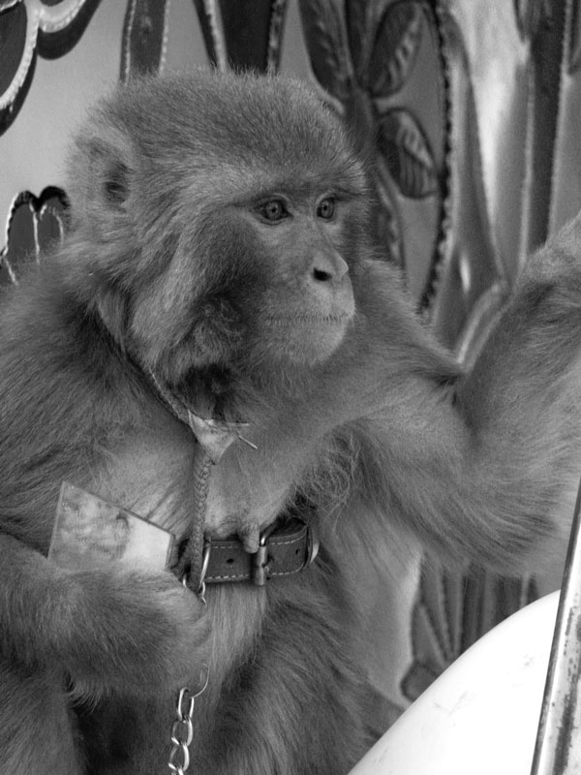
Monkey Bites: Special Considerations
Macaque monkeys are native to central and Southeast Asia, including eastern Afghanistan, and are often kept as pets.
Monkeys in the macaque group can carry Simian Herpes B virus (SHBV).
  A rare but highly fatal encephalomyelitis in humans (up to 80% of cases)
  Infected monkeys may be able to transmit SHBV but not show clinical signs
http://wwwnc.cdc.gov/eid/article/18/10/12-0419-f1.htm
Notes:
Rhesus macaque monkeys are native to eastern Afghanistan and throughout central and Southeast Asia. They are often kept as pets or mascots by local nationals. In addition to rabies, monkeys in the macaque group can carry Simian Herpes B virus (SHBV). Although rare, SHBV causes an encephalomyelitis in humans that is fatal in up to 80% of cases. A monkey infected with rabies or SHBV may not have clinical signs even though it can transmit the disease.
Disease risk appears to vary with type of exposure. The riskiest exposures appear to include deep puncture wounds that are difficult to clean, inadequately cleansed wounds, and wounds sustained on the face (especially wounds to the eye), neck, or thorax-that is, like rabies, sites nearer the CNS. Ocular splashes with infected fluids, such as saliva, may also transmit SHBV.

Slide 17
Monkey Bites: Special Considerations
Treatment for bites by macaque monkeys should include:
  Immediate wound/mucous membrane cleansing for at least 15 minutes
  Antiviral medication within 24 hrs to 5 days of the bite (see below)
  Baseline testing for antibodies against SHBV
  Rabies post-exposure prophylaxis (PEP)
  Ensure SM’s tetanus status is current
  Consider antibiotic prophylaxis for prophylaxis of skin infections with oral flora
  Follow-up testing for SHBV seroconversion should be done at 2, 4 and 6 weeks and finally 3 months after exposure.
Consult infectious disease physicians for questions.
Use either Valacyclovir or Acyclovir for prophylaxis.
  Valacylovir—1g by mouth every 8 hours for 14 days, or
  Acyclovir—800 mg by mouth 5 times daily for 14 days
Neither is contraindicated with RIG or rabies vaccine.
Notes:
Additional information is available at: http://www.cdc.gov/herpesbvirus/index.html and http://cid.oxfordjournals.org/content/35/10/1191.full.pdf+html. See also http://wwwnc.cdc.gov/eid/article/18/10/12-0419_article.htm

Slide 18
AHLTA Documentation
Document circumstances of exposure, including date, location and activities leading to exposure
  Enables Rabies Advisory Board to evaluate exposure risk
  Helps to corroborate veterinary reports and lab results
Document any wounds, including location
Document prior rabies vaccinations, current medications and medical conditions
  Prior rabies vaccinations and/or HRIG immunization
  High-dose steroid or other immunosuppressive therapies or medical conditions require 5 vaccine doses instead of 4 (e.g., taking malaria pills)
Notes:
In the patient encounter note, be certain to document the circumstances of exposure, including date, location and activities leading to exposure. Doing so enables the local Rabies Advisory Board to evaluate exposure risk, and helps to corroborate veterinary reports and lab results. Document any wounds, including location. Also document prior rabies vaccinations, current medications and medical conditions. This includes prior rabies vaccinations and/or HRIG immunization, high-dose steroid or other immunosuppresive therapies or medical conditions require 5 vaccine doses instead of 4 (e.g., taking malaria pills).

Slide 19
AHLTA Documentation
Record treatment provided
  Copious washing of wound for > 15 minutes
  Administration of HRIG
  Vaccine inoculation site
  Lot number and expiration date
Document plan for subsequent vaccination
  If providing vials for administration at forward location, document cold chain plan (between 36 and 46 °F)
  Provide contact number to track case to completion
  Public health nurses can assist with ensuring follow-up
Document any reasons for discontinuing vaccination series
Notes:
Additionally, record treatment provided
Copious washing of wound for > 15 minutes
Administration of HRIG
Vaccine inoculation site
Lot number and expiration date
And document the plan for subsequent vaccination. If providing vials for administration at forward location, document cold chain plan (between 36 and 46 °F). Provide patient’s contact number to track case to completion. Public health nurses can assist with ensuring follow-up. Lastly, document any reasons for discontinuing vaccination series. This prevents confusion later.

Slide 20
MEDPROS Documentation
All HRIG and rabies vaccine doses must be entered into MEDPROS or other Service-specific immunization tracking program
  Active duty, Reserve or National Guard
  DA civilians who are deployable
  DoD contractors eligible for care in theater
Notes:
All HRIG and rabies vaccine doses must be entered into MEDPROS or service-specific immunization tracking program.
Active duty, Reserve or National Guard
DA civilians who are deployable
DoD contractors eligible for care in theater

Slide 21
Evaluating Past Exposures
-Patient presents for care well after event-
All risk events MUST be appropriately documented in AHLTA
All suspected rabies exposures MUST be treated with HRIG and Rabies Vaccine as appropriate
  There is no time limit for treatment with HRIG and vaccine
    Infiltrate site of wound or exposure with HRIG, even if injury is healed
    Remainder of HRIG should be administered in other deltoid or anterior-lateral aspect of the quadriceps (thigh) region, distal from vaccination site
  Only persons who have received previous rabies vaccinations should not receive HRIG
  See algorithm for additional details
Report case to Preventive Medicine/Public Health at military treatment facility to ensure patient receives appropriate follow-up
Preventive Medicine will coordinate with veterinarians to convene a Rabies Advisory Board to review all cases
Notes:
When evaluating persons who report a past exposure, be certain to document all risk events appropriately in AHLTA. A template is being developed to ensure complete history is captured and appropriate ICD9 and CPT codes are captured. All suspected rabies exposures MUST be treated with HRIG and Rabies Vaccine as appropriate. There is no time limit for treatment with HRIG or vaccine. Infiltrate site of wound or exposure with HRIG, even if injury is healed. Remainder of HRIG should be administered in other deltoid or anterior-lateral aspect of the quadriceps (thigh) region, distal from vaccination siteOnly persons who have received previous vaccinations should not receive HRIG. The algorithm on the next slide has additional details.
Report case to Preventive Medicine to ensure patient receives appropriate follow-up. Preventive Medicine will coordinate with veterinarians to convene a Rabies Advisory Board to review all cases.

Slide 22
Evaluation and Treatment of Potential
Deployment-Related Rabies Exposures
IMPORTANT: THIS ALGORITHM SHOULD NOT BE USED TO EVALUATE ACUTE BITES OR EXPOSURES¹
Note: This algorithm is primarily intended to apply to risk exposures reported after a delay and associated with deployments to countries with Intermediate or High Rabies Risk as assessed by NCMI.
Notes:
This algorithm provides guidance for determining what exposures should be considered for treatment with PEP The algorithm is primarily intended to apply to deployments to countries with Intermediate or High Rabies Risk as assessed by NCMI. Keep in mind it is NOT intended to be used for assessing acute rabies risk exposures.

Slide 23
Resources
Local Preventive Medicine/Public Health/Veterinary Officers
Phone:
Email:
US Army Public Health Command Rabies Response Team
Phone: (800) 984-8523 OR DSN 312-421-3700
Email: PHCRabiesInfo@amedd.army.mil
http://phc.amedd.army.mil/topics/discond/aid/Pages/Rabies.aspx
References
US Centers for Disease Control and Prevention (CDC) Rabies Website http://www.cdc.gov/rabies/
MMWR: March 19, 2010 / 59(RR02); 1-9: Use of a Reduced (4-Dose) Vaccine Schedule for Postexposure Prophylaxis to Prevent Human Rabies http://www.cdc.gov/mmwr/preview/mmwrhtml/rr5902a1.htm
MMWR: May 23, 2008 / 57(RR03); 1-26,28: Human Rabies Prevention --- United States, 2008 http://www.cdc.gov/mmwr/preview/mmwrhtml/rr5703a1.htm
USAPHC Rabies Fact Sheet available at Rabies Response Team webpage above
Notes:
Here is a list of additional resources

Slide 24
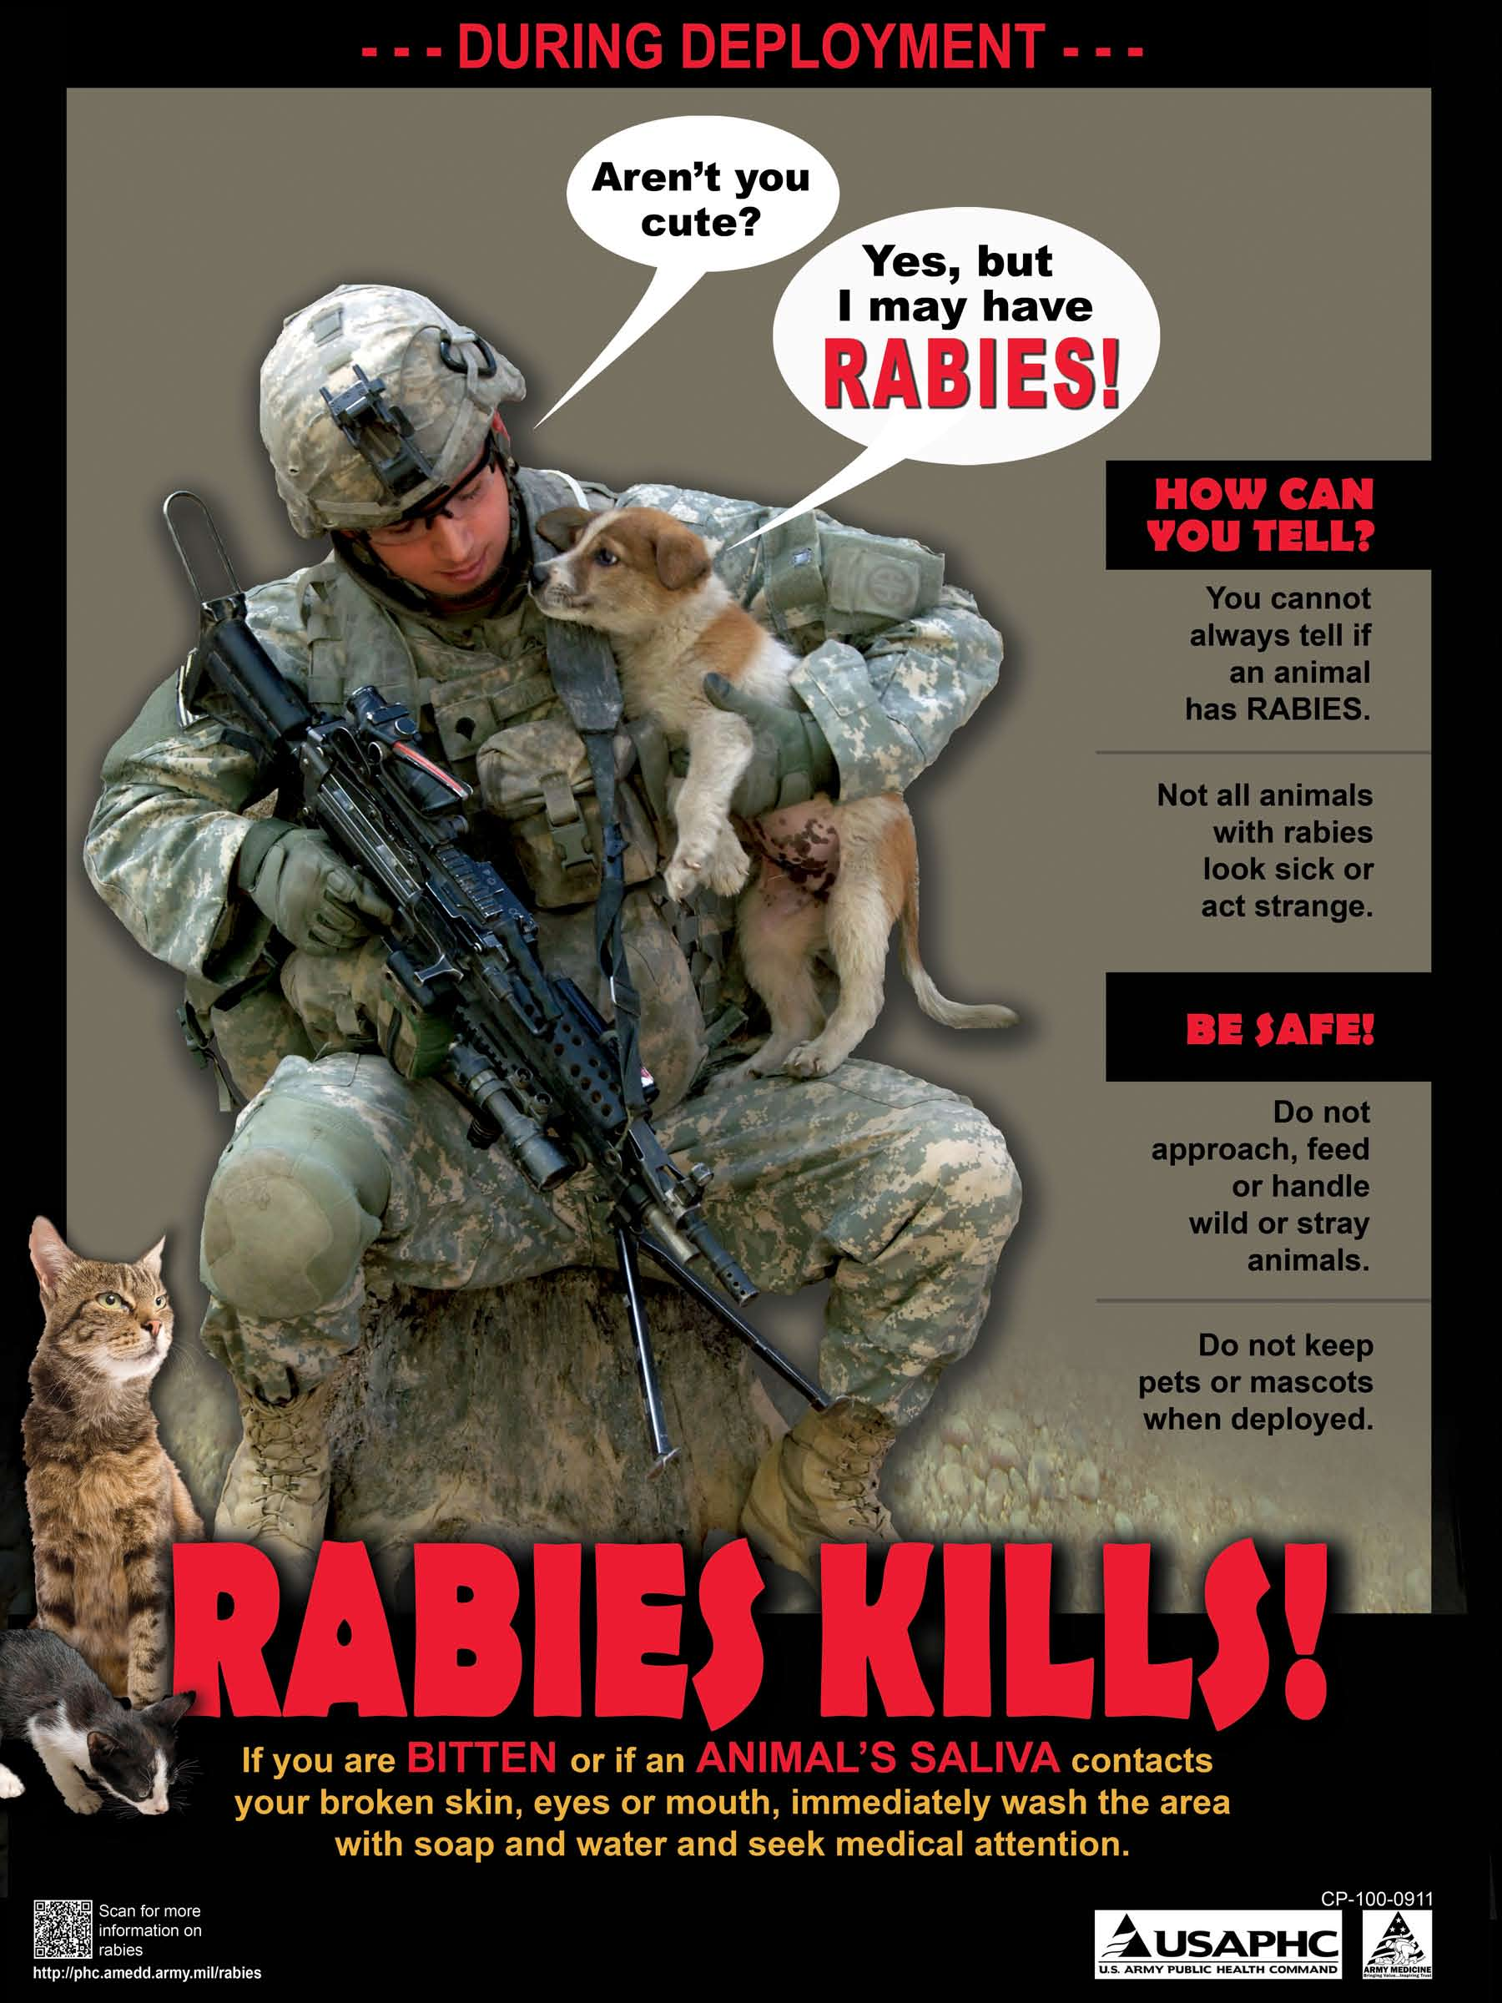
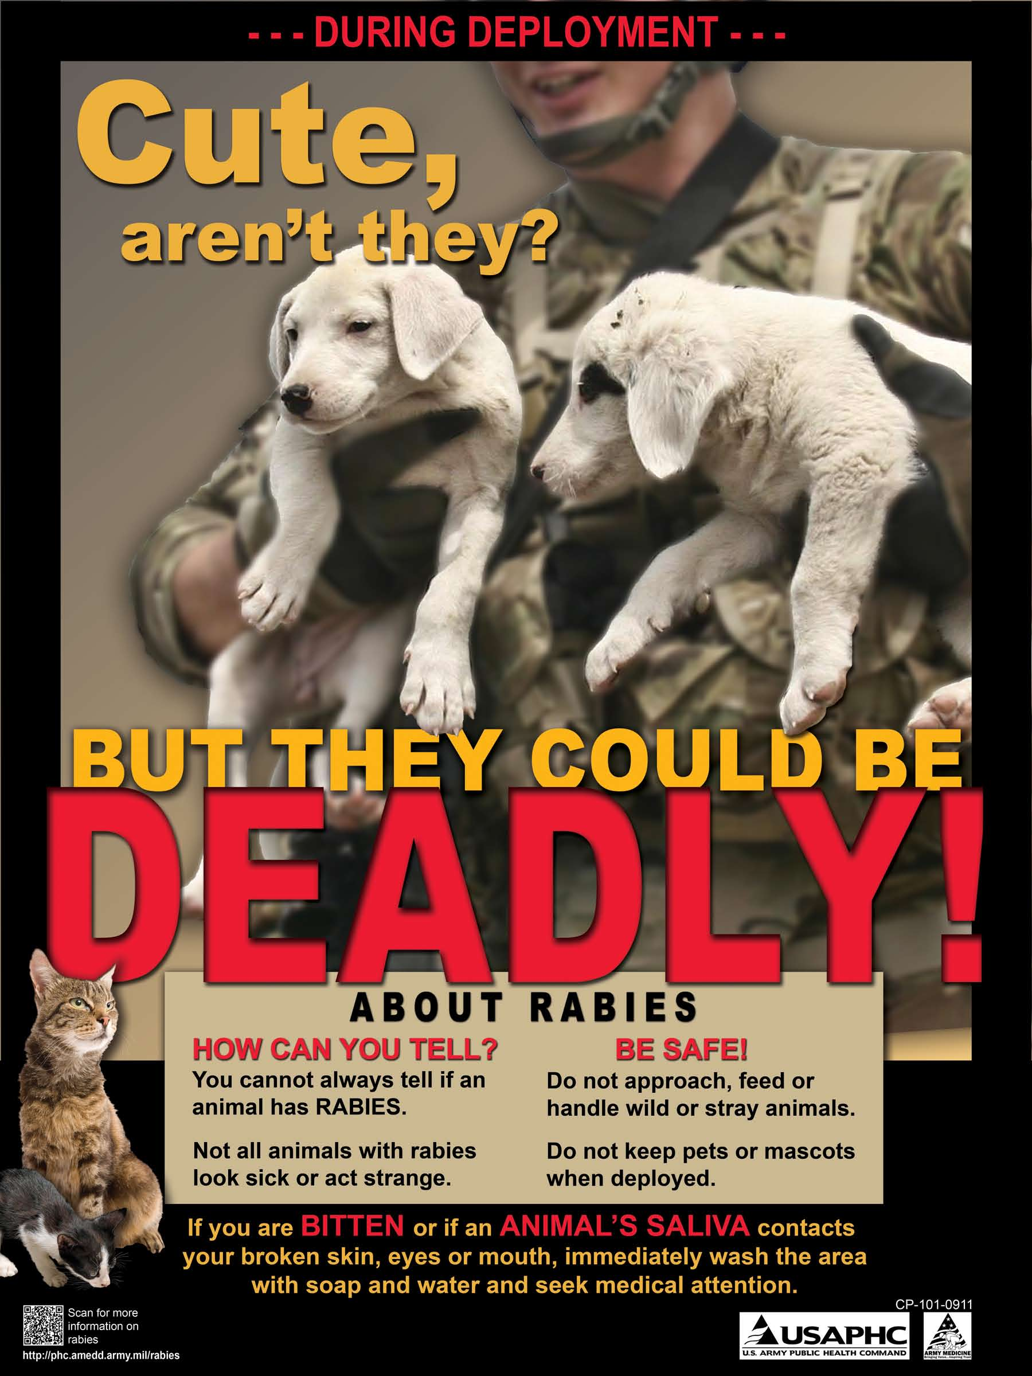
Notes:
Questions?

